Slide 1
CSCI 111 Web Programming and Problem Solving
Section 1
PART III Artificial Intelligence
Weeks [12 - 15]
Week-12-lecture: Machine Learning
Instructor: Dr. Talgat Manglayev

Slide 2
CONTENT
Introduction
Machine Learning example
Deep Learning examples
Machine Learning
One more example of ML
Terms
Summary

Slide 3
There is no clear definition of "intelligence"

Slide 4
INTRODUCTION
programs use algorithms upon data and return result
data + algorithms = result
AI use data and their results to develop algorithms for another results
data + results = algorithms

Slide 5
INTRODUCTION. Some scary math
5
∑ = 1 + 2 + 3 + 4 + 5
i=1

Slide 6
INTRODUCTION. Some scary math
P(A|B) = 0.7

Slide 7
INTRODUCTION. Some scary math
P(A|B) = 0.7
Conditional probability.
The probability that an event A occurs given that another event B already occurs.
A - Snow
B - Live in Astana
The probability that it snows today given that we live in Astana is 70%

Slide 8
ML ⊂ AI
Artificial Intelligence (AI)
Machine Learning (ML)
supervised
classification
regression
unsupervised
reinforcement
Neural Networks (NN)
Deep Learning (DL)
big data, strong AI

Slide 9
AI Examples
Artificial Intelligence (AI)
Machine Learning (ML)
supervised
classification
regression
unsupervised
reinforcement
Neural Networks (NN)
Deep Learning (DL)
big data, strong AI

Slide 10
ML Example. Buy a phone.
BUY A PHONE
Human. Logic and Reasoning.
Look carefully for features such as
brand, price, memory, display size, camera
etc.
Find the most optimal combination.

Slide 11
ML Example. Buy a phone.
BUY A PHONE
Human. Experience.
Ask friends what phone they have and what they like and dislike about it.
Form a list of information and use that list to decide.

Slide 12
ML Example. Buy a phone.
Human. Experience. Machine Learning. Data.
Ask friends what phone they have and what they like and dislike about it.
Form a list of information then use that list to decide.
Remember Formulate Predict.

Slide 13
ML Example. Buy a phone.
Machine Learning use Data:
Decide:
phone name | like | dislike
iphone 16 pro | photo camera | video camera
iphone 16 | display size | price
Samsung s24 | S Pen | weight
Huawei Mate X3 | double screen | operating system
best phone name

Slide 14
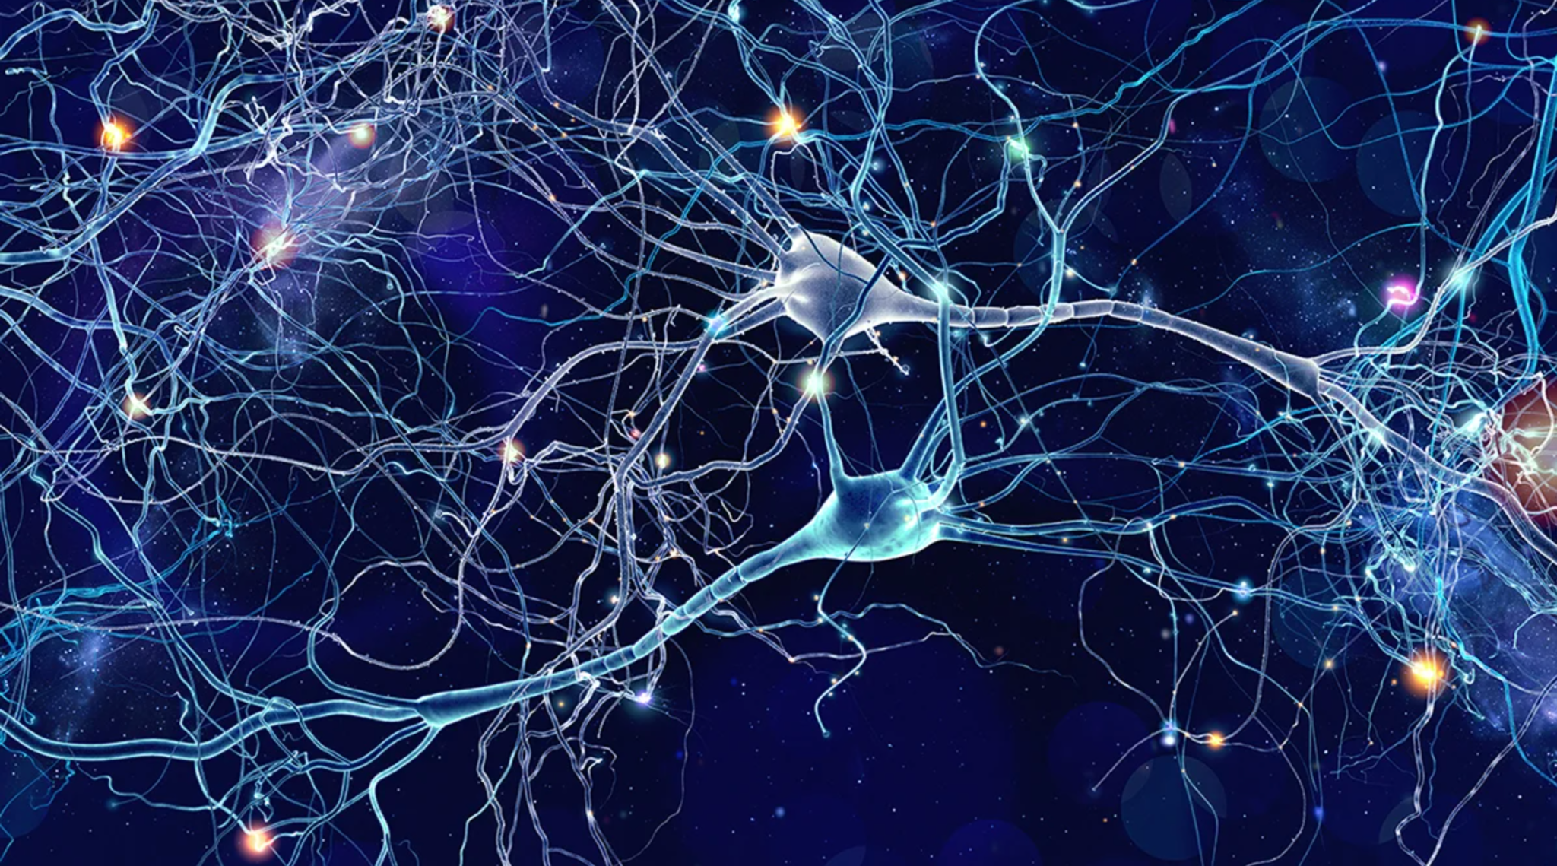
Deep Learning (DL ⊂ ML)
Neurons - are the fundamental units of the brain and nervous system, the cells responsible for
receiving sensory input from the external world,
sending motor commands to our muscles,
transforming and relaying the electrical signals at every step in between.
Approximately 86 billion neurons
form 100 trillion connections in human brain.
https://qbi.uq.edu.au/brain/brain-anatomy/what-neuron
https://hms.harvard.edu/news/new-field-neuroscience-aims-map-connections-brain
https://www.nature.com/scitable/blog/brain-metrics/are_there_really_as_many/
https://news.ucr.edu/articles/2020/07/24/neurons-are-genetically-programmed-have-long-lives

Slide 15
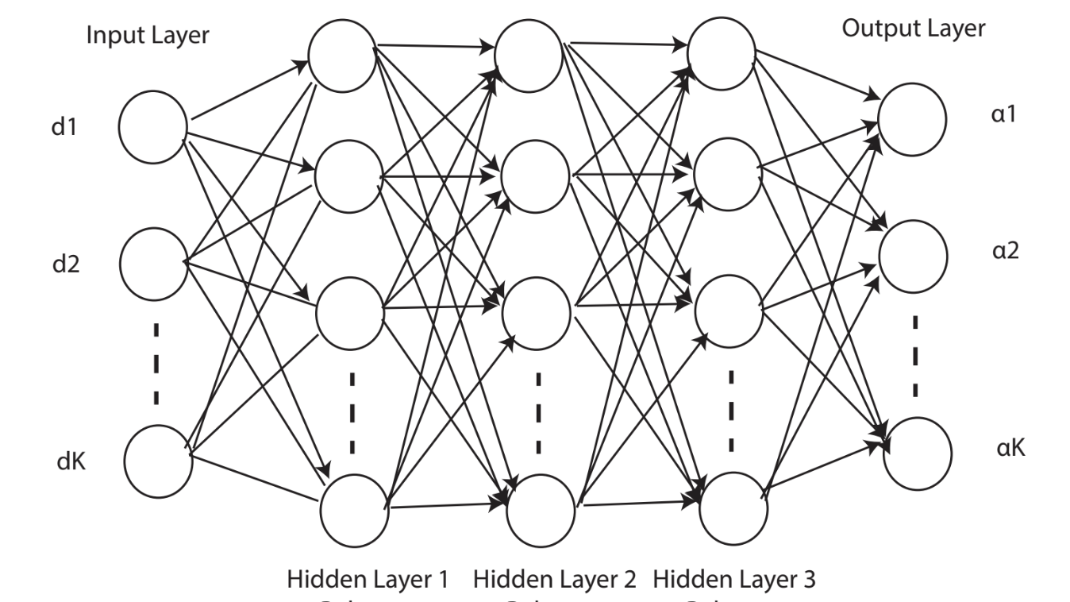
Deep Learning (DL ⊂ ML)
(Artificial) Neural Networks (NN) are meant to mimic how the human brain operates.
Deep Learning is a field of ML which use NN.
DL popularity due to::
Processors became fast enough
Storage became large enough
Training and tuning improved
https://link.springer.com/article/10.1007/s11277-022-09511-6

Slide 16
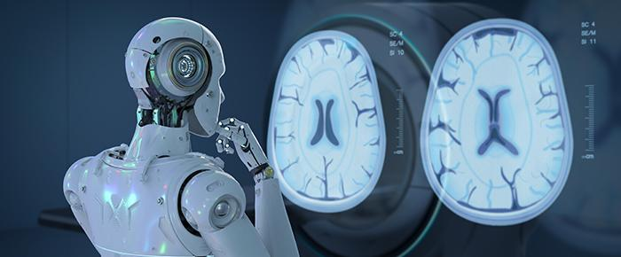
Deep Learning Application Examples
Image recognition
Medical Diagnosis
https://blog.labtag.com/wp-content/uploads/2021/10/0139-Diagnostic-AI-700x290px.jpg

Slide 17
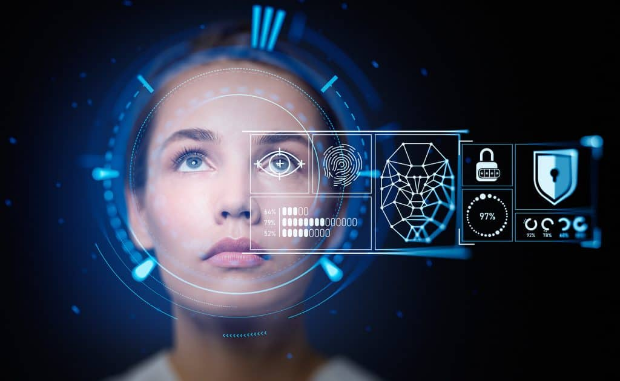
Deep Learning Application Examples
Image recognition
Medical Diagnosis
Face Detection
https://itchronicles.com/wp-content/uploads/2023/07/face-recognition-1024x630.jpg

Slide 18
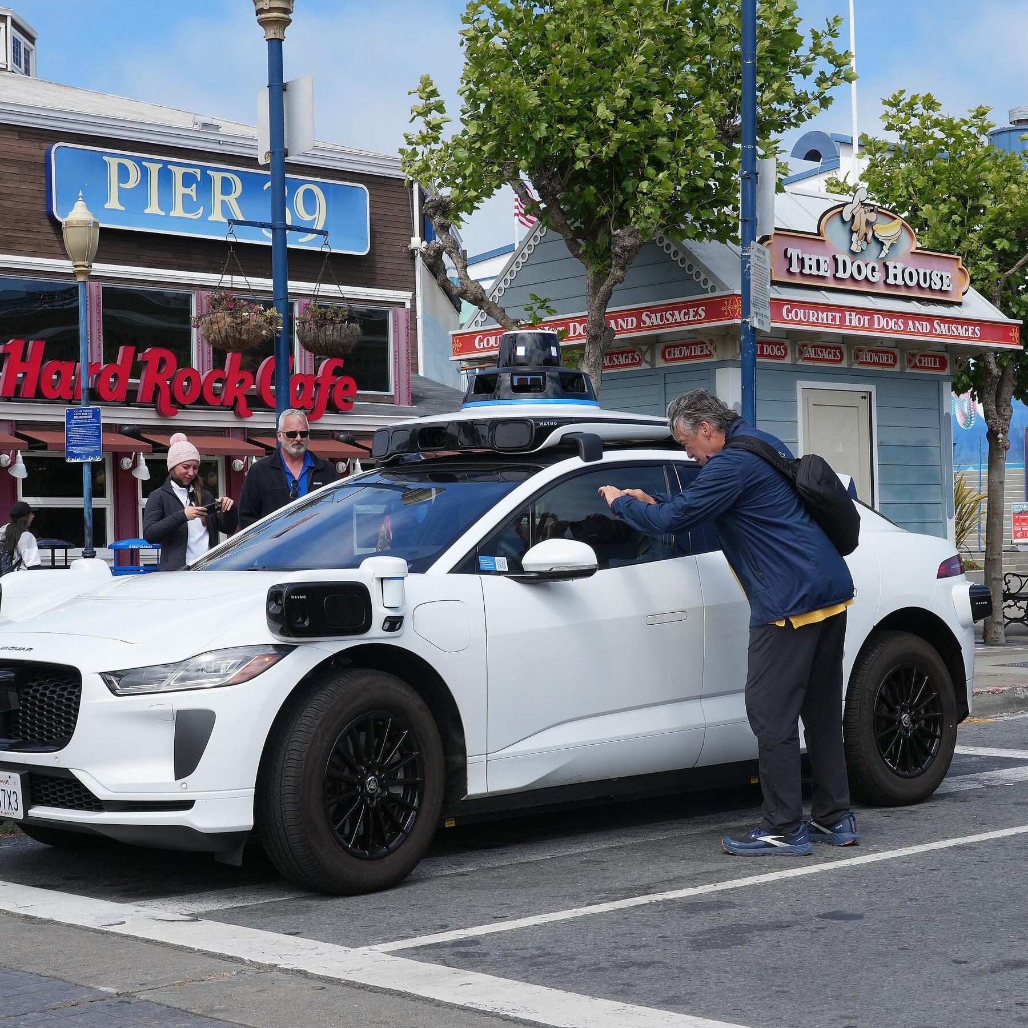
Deep Learning Application Examples
Image recognition
Medical Diagnosis
Face Detection
Self-driving cars
https://static01.nyt.com/images/2024/05/22/multimedia/22sf-driverless-cars-tvqz/22sf-driverless-cars-tvqz-mediumSquareAt3X.jpg

Slide 19
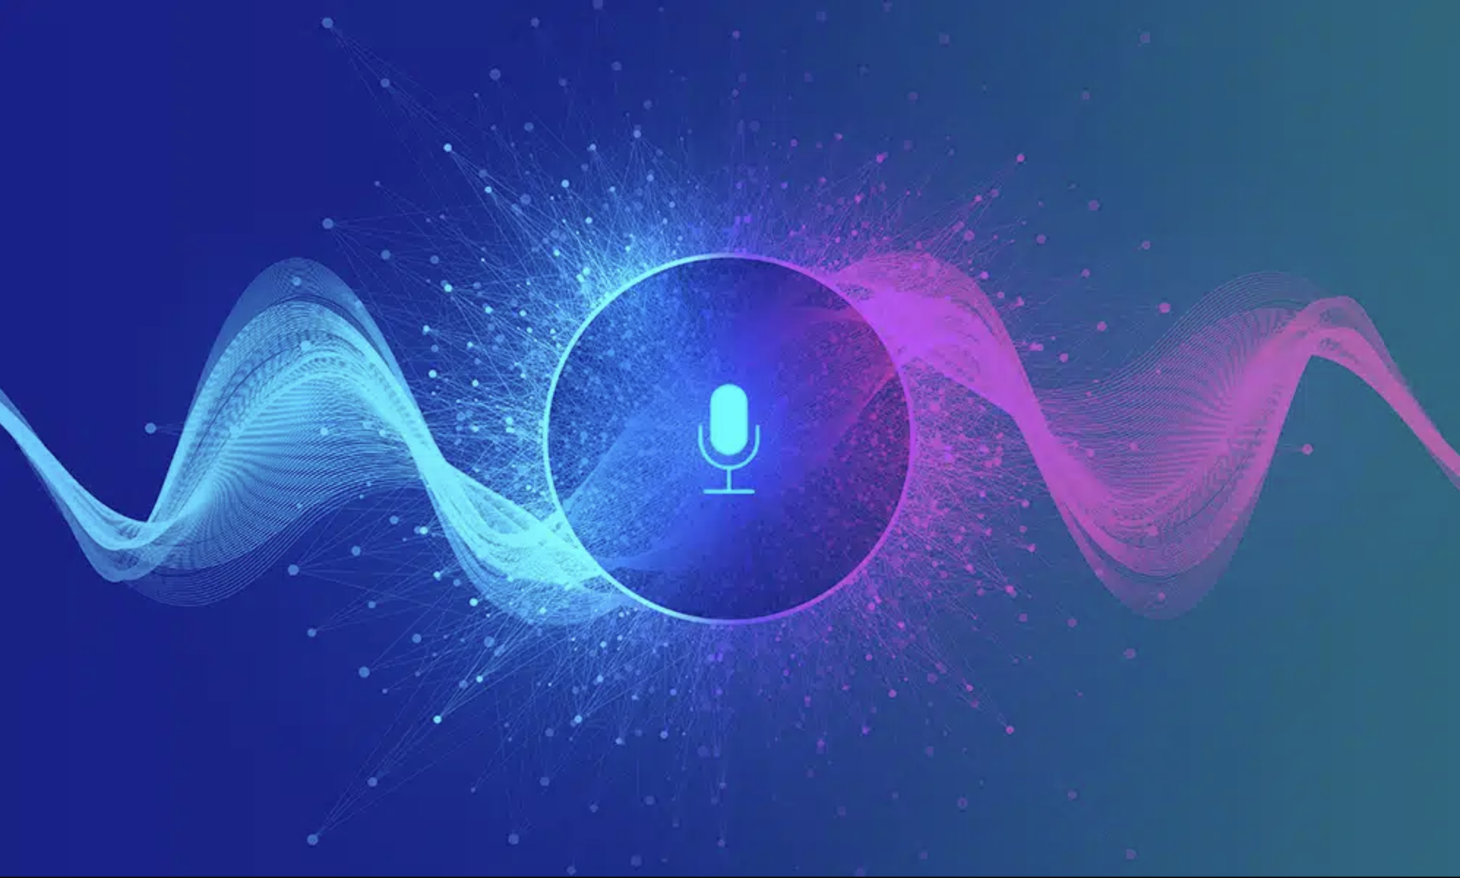
Deep Learning Application Examples
Image recognition
Medical Diagnosis
Face Detection
Self-driving cars
Voice Recognition
https://www.shaip.com/wp-content/uploads/2022/12/Blog_Difference-Between-Speech-Voice-Recognition.jpg

Slide 20
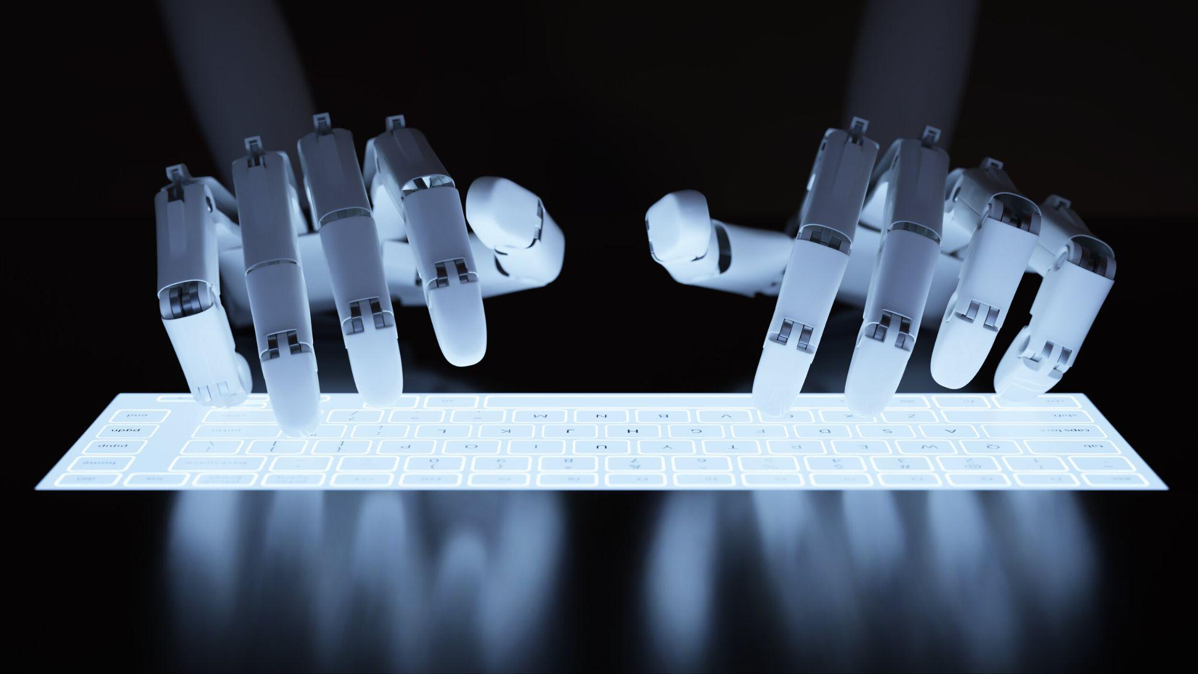
Deep Learning Application Examples
Image recognition
Medical Diagnosis
Face Detection
Self-driving cars
Voice Recognition
Text generation
https://images.squarespace-cdn.com/content/v1/57462f541bbee075320514a9/1624462944359-1UDIFWK5V8FZATQNKVXY/shutterstock_403937386.jpg

Slide 21
Machine Learning
Teach computer to
REMEMBER data
FORMULATE rule model
PREDICT the result

Slide 22
Machine Learning
Teach computer to
REMEMBER data
FORMULATE rule model
PREDICT the result
Model - is a set of rules that represent our data and can be used to make predictions

Slide 23
Machine Learning
Teach computer to
REMEMBER data
FORMULATE rule model
PREDICT the result
Model - is a set of rules that represent our data and can be used to make predictions
Algorithm - is a set of steps to solve a problem. In ML to build a model.

Slide 24
Machine Learning
Teach computer to
REMEMBER data
FORMULATE rule model
PREDICT the result
Model - is a set of rules that represent our data and can be used to make predictions
Algorithm - is a set of steps to solve a problem build a model.

Slide 25
SPAM from Friend. Model 1.
Our friend Kenes often sends us messages.
Looking at the last 10 messages we recognize that mostly they are not urgent:
There are 6 spam messages and 4 not spam
When new message is received we may roughly conclude that it is spam.

Slide 26
SPAM from Friend. Model 2.
We start to look at emails and pay attention to days of the week:
Monday: Meaningful
Tuesday: Meaningful
Saturday: Spam
Sunday: Spam
Sunday: Spam
Wednesday: Meaningful
Friday: Meaningful
Saturday: Spam
Tuesday: Meaningful
Thursday: Meaningful
When new message is received on weekends we may roughly conclude that it is spam.

Slide 27
SPAM from Friend. Model 3.
Once we meet Kenes and he asks why have I missed his birthday last Sunday.

Slide 28
SPAM from Friend. Model 3.
Once we meet Kenes and he asks why have I missed his birthday last Sunday.
We need to look at data again:
1 KB: Meaningful
2 KB: Meaningful
16 KB: Spam
20 KB: Spam
18 KB: Spam
3 KB: Meaningful
5 KB: Meaningful
25 KB: Spam
1 KB: Meaningful
3 KB: Meaningful
Any email of size 10 KB or larger is spam, and any email of size less than 10 KB is meaningful.

Slide 29
SPAM from Friend. Model 4.
If an email is larger than 10 KB or it is sent on the weekend, then it is classified as spam. Otherwise, it is classified as meaningful.
Monday: Meaningful
Tuesday: Meaningful
Saturday: Spam
Sunday: Spam
Sunday: Spam
Wednesday: Meaningful
Friday: Meaningful
Saturday: Spam
Tuesday: Meaningful
Thursday: Meaningful
1 KB: Meaningful
2 KB: Meaningful
16 KB: Spam
20 KB: Spam
18 KB: Spam
3 KB: Meaningful
5 KB: Meaningful
25 KB: Spam
1 KB: Meaningful
3 KB: Meaningful
days of the week and size are features

Slide 30
SPAM from Friend. More Models.
Monday: Meaningful
Tuesday: Meaningful
Saturday: Spam
Sunday: Spam
Sunday: Spam
Wednesday: Meaningful
Friday: Meaningful
Saturday: Spam
Tuesday: Meaningful
Thursday: Meaningful
1 KB: Meaningful
2 KB: Meaningful
16 KB: Spam
20 KB: Spam
18 KB: Spam
3 KB: Meaningful
5 KB: Meaningful
25 KB: Spam
1 KB: Meaningful
3 KB: Meaningful
If the email is sent during the week,
then it must be larger than 15 KB
to be classified as spam.
If the email is sent during the weekend,
then it must be larger than 5 KB
to be classified as spam.
Otherwise, it is classified as meaningful.

Slide 31
SPAM from Friend. More Models.
Monday: Meaningful
Tuesday: Meaningful
Saturday: Spam
Sunday: Spam
Sunday: Spam
Wednesday: Meaningful
Friday: Meaningful
Saturday: Spam
Tuesday: Meaningful
Thursday: Meaningful
1 KB: Meaningful
2 KB: Meaningful
16 KB: Spam
20 KB: Spam
18 KB: Spam
3 KB: Meaningful
5 KB: Meaningful
25 KB: Spam
1 KB: Meaningful
3 KB: Meaningful
Consider the number of the day, where
Monday is 0,
Tuesday is 1,
Wednesday is 2,
Thursday is 3,
Friday is 4,
Saturday is 5,
Sunday is 6.
If we add the number of the day and
the size of the email (in KB),
and the result is 12 or more,
then the email is classified as spam.
Otherwise, it is classified as meaningful.

Slide 32
Machine Learning
REMEMBER: Look at a huge table of data.
FORMULATE MODEL: Go through many rules and formulas, and check which model fits the data best.
PREDICT: Use the model to make predictions about future data.

Slide 33
SPAM from Friend. Some More Features.
If the email has two or more spelling mistakes, then it is classified as spam.
If it has an attachment larger than 10 KB, it is classified as spam.
If the sender is not in our contact list, it is classified as spam.
If it has the words buy and win, it is classified as spam.
Otherwise, it is classified as meaningful.
if (size) > 10
and
if (number of spelling mistakes) + (number of appearances of the word “buy”) > 10
then we classify the message as spam.
Otherwise, we classify it as meaningful.

Slide 34
Terms
"Machine Learning - is a common sense done by a computer."
Grokking Machine Learning, Luis Serrano 2021
"Machine Learning is a subfield of computer science that gives computers the ability to learn without being programmed"
Arthur Samuel, IBM Journal of Research and Development, Vol. 3, 1959
"Artificial intelligence refers to the simulation of human intelligence in machines that are programmed to think like humans and mimic their actions."
Investopedia 2022
"Artificial Intelligence is the set of all tasks in which a computer can make decisions"
Grokking Machine Learning, Luis Serrano 2021

Slide 35
Summary
Machine Learning is …
not difficult to start
applied in science, social problems, medicine etc.
common sense, done by a computer. It mimics the ways humans think to make decisions quickly and accurately.
make decisions based on previous data by computers like humans make decisions on experience.

Slide 36
Self work
https://www.w3schools.com/ai/default.asp
https://www.w3schools.com/ai/ai_history_brain.asp
Serrano, L., 2021. Grokking machine learning. Simon and Schuster. Chapter 1

